Slide 1
Analysis of Measures Adopted to Stop The Spread
Covid-19 Pandemic
Group 4: Hajar, Helena, Hussam, Jack

Slide 2
Overview
Each country had its own approach to tackling the COVID-19 pandemic and government leaders were scrutinised for their COVID-19 related mandates and policies.
What did we learn from the way the COVID-19 pandemic was managed?
What was the incidence of COVID-19 pre and post vaccinations?
Were the government mandates including face coverings a contributing factor?
Compare hospital beds and number of testing to number of COVID-19 cases
Research Question
Produce:
What were the factors that drove COVID-19 outcomes from 2020 to 2022?
Evaluation of measures that were adopted by governments around the world to manage COVID 19 outbreak.

Slide 3
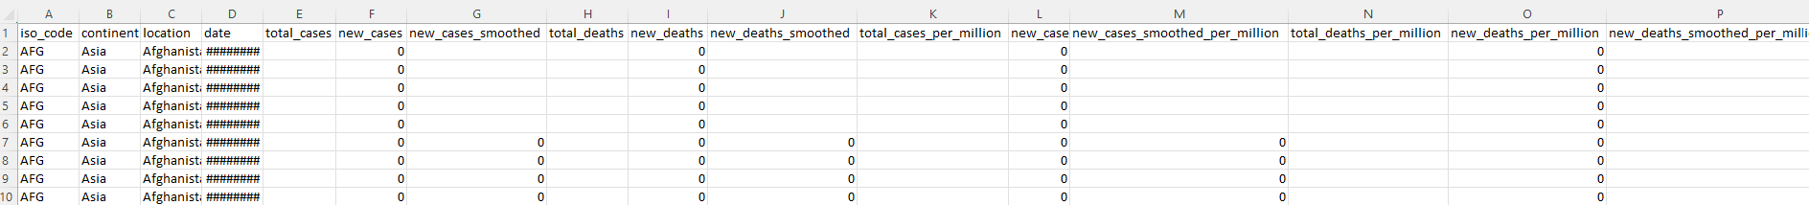

Source of Data
Our World in Data: A collaborative effort between University of Oxford and the Global Change Date Lab, a registered non-for-profit organization based in the UK
World Bank API to retrieve income levels
Main link to Data: https://ourworldindata.org/coronavirus
Data file location and format: https://github.com/owid/covid-19-data/blob/master/public/data/owid-covid-data.csv

Slide 4
What Was The Incidence of Covid-19 Pre and Post Vaccinations?

Slide 5
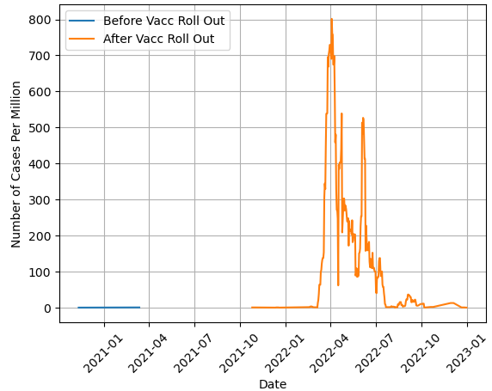
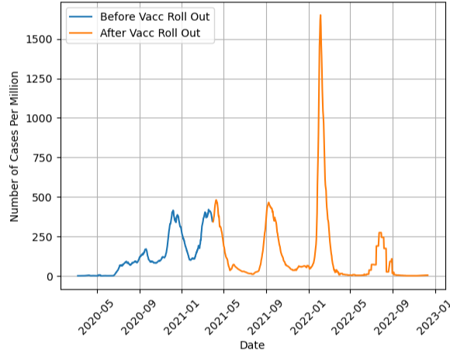
Data Summary and Cleaning
Original Number of Countries: 240+
Date Range: Jan 2020 - Dec 2022
Cleaning Process - Removing Locations:
without cases recorded pre vaccine roll-out
Without cases recorded post vaccine roll-out
grouped together
with questionable over-all trend

Slide 6
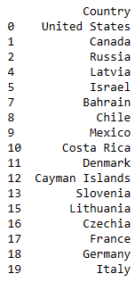
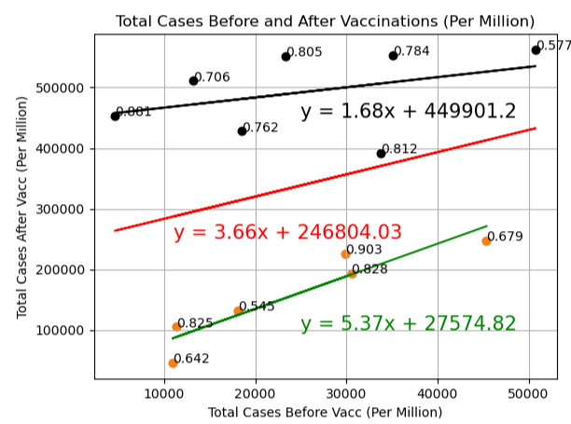
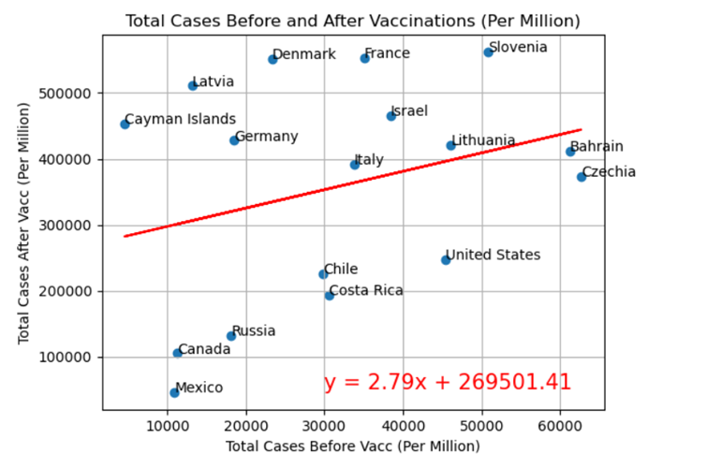
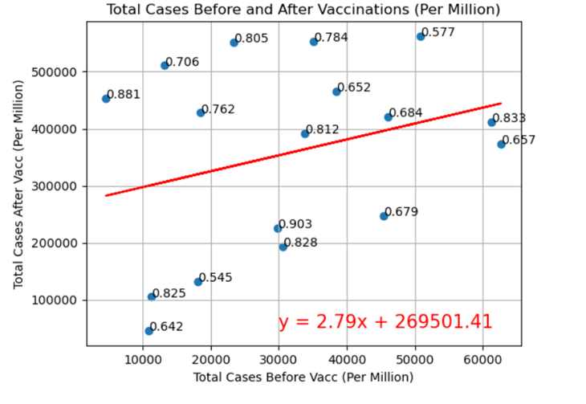
Analysis – Top 20 Locations
Earliest Vaccine roll-out date: Dec 2020
Two-week period
Mid to high ratio of population vaccinated
Two main clouds of data; Americas and Europe
Per continent:
Americas: rate of change of 5.37 with initial jump of 27574 in cases, wider range of variation
Europe: rate of change of 1.68 with initial jump of 449901 in cases, narrow range of variation

Slide 7
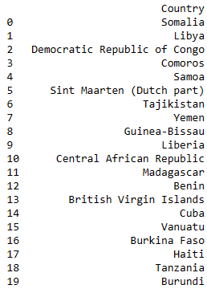
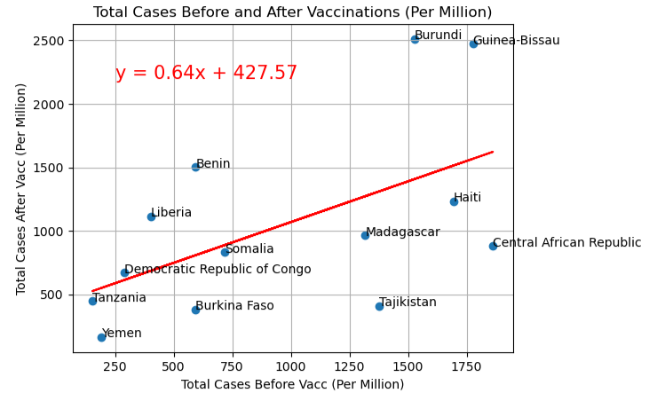
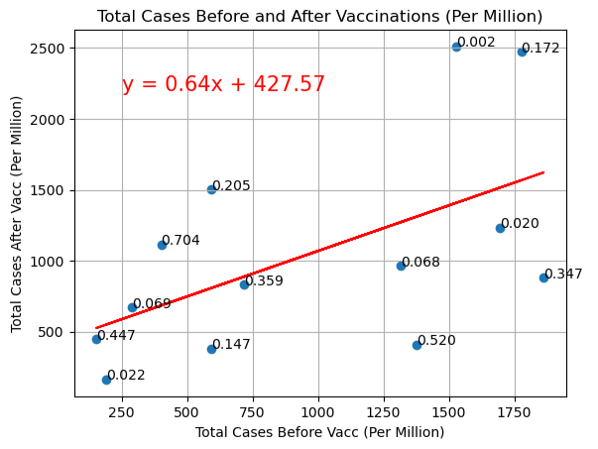
Analysis – Bottom 20 Locations
Earliest Vaccine roll-out date: April 2021
Six-month period
Low to Mid ratio of population vaccinated
Mainly African countries
Unrealistic date
Very low number of cases
Bad reporting system (?)

Slide 8
Were Government Mandates Effective in Stopping the Spread of Covid-19?

Slide 9
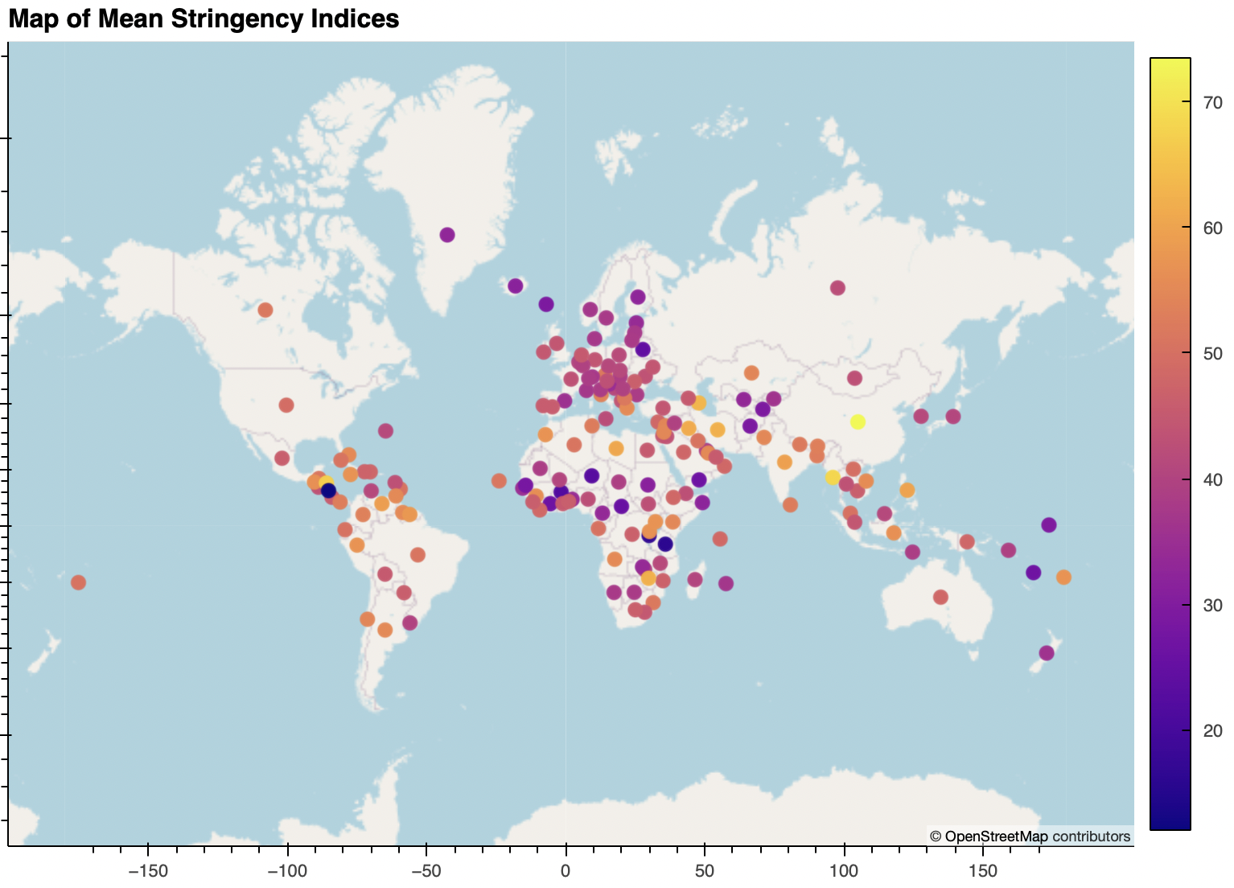
Stringency Index
The stringency index is the average of 9 separate metrics that measure the severity of,
School closures
Workplace closures
Cancellation of public events
Restrictions of public gatherings
Closures of public transport
Stay-at-home requirements
Public information campaigns
Restrictions of internal movements
International travel controls
and is on a scale from 0 (no policy) to 100 (strictest possible) that varied from day-to-day.

Slide 10
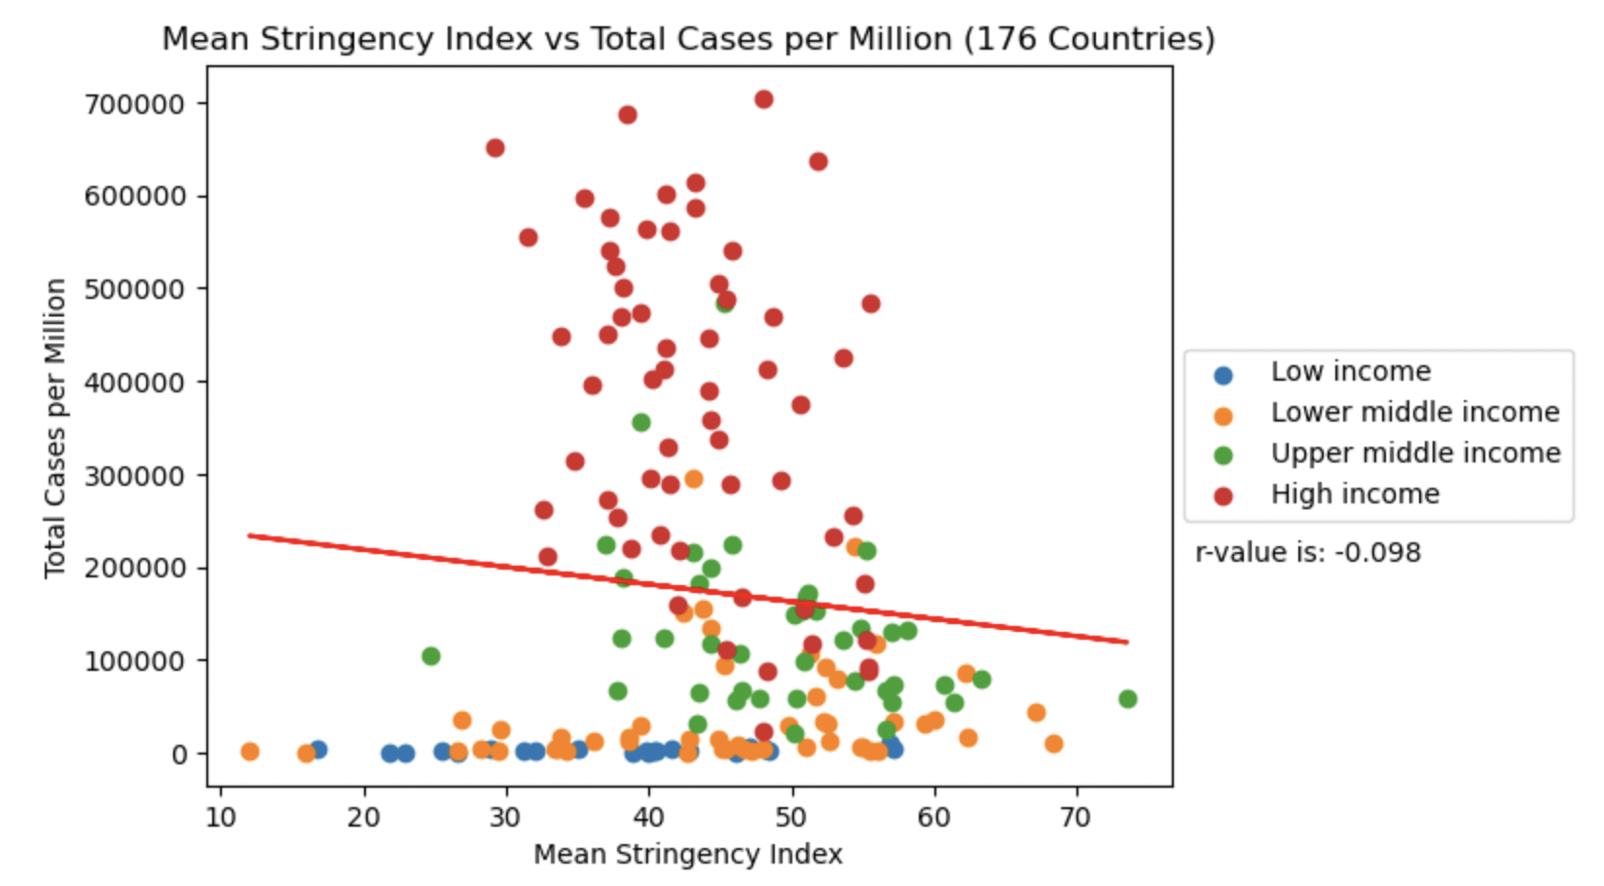
Stringency Index vs Total Cases per Million
Weak negative relationship between infection rate and mean stringency index for all countries (r value -0.098)
Weak to moderate negative relationship for upper middle and high income countries (r value of -0.46)
This discrepancy may be due to under reporting of infection numbers in poorer countries.

Slide 11
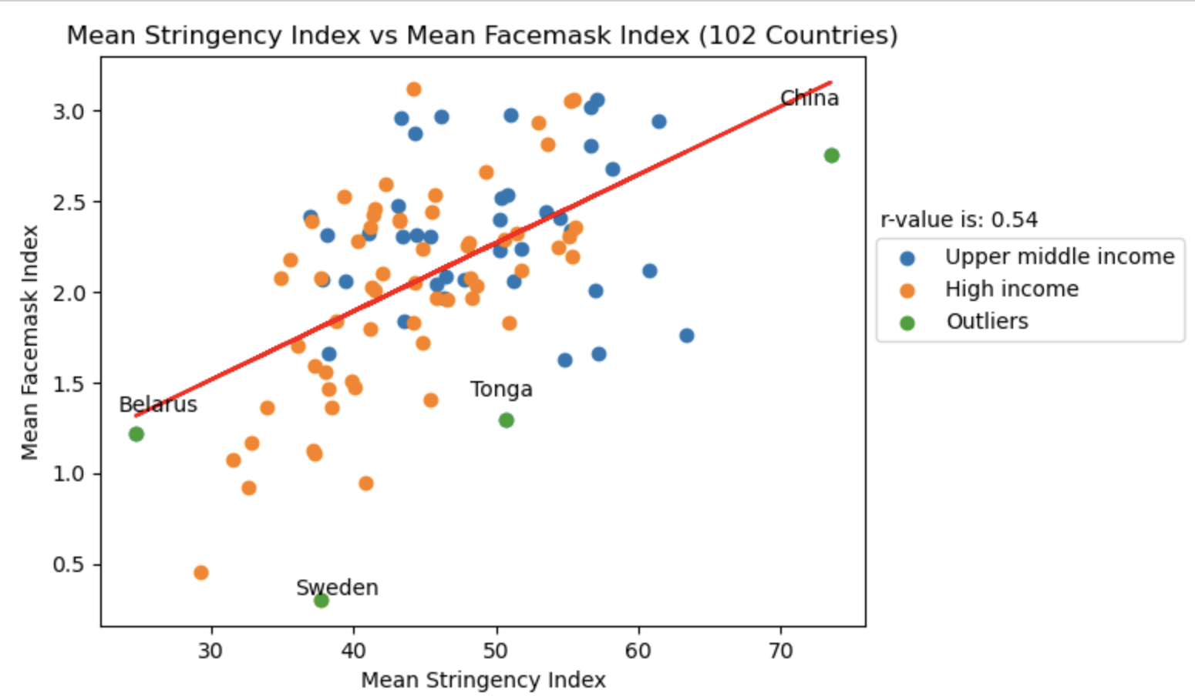
Summary of Findings for Policy Analysis
Results suggest that government mandates were somewhat effective in slowing the spread of Covid-19.
Weak negative relationship between face mask requirements and infection rates (r values is -0.3).
Any indication that face masks were effective could be misleading due to correlation between strictness of face mask requirements and strictness of lockdowns (or vice versa)
Face mask index:
0 - No policy
1 - Recommend
2 - Required in some public areas
3 - Required in all public areas
4 - Required at all times outside the home

Slide 12
Assessing Healthcare Access
Hospital Beds per Capita

Slide 13
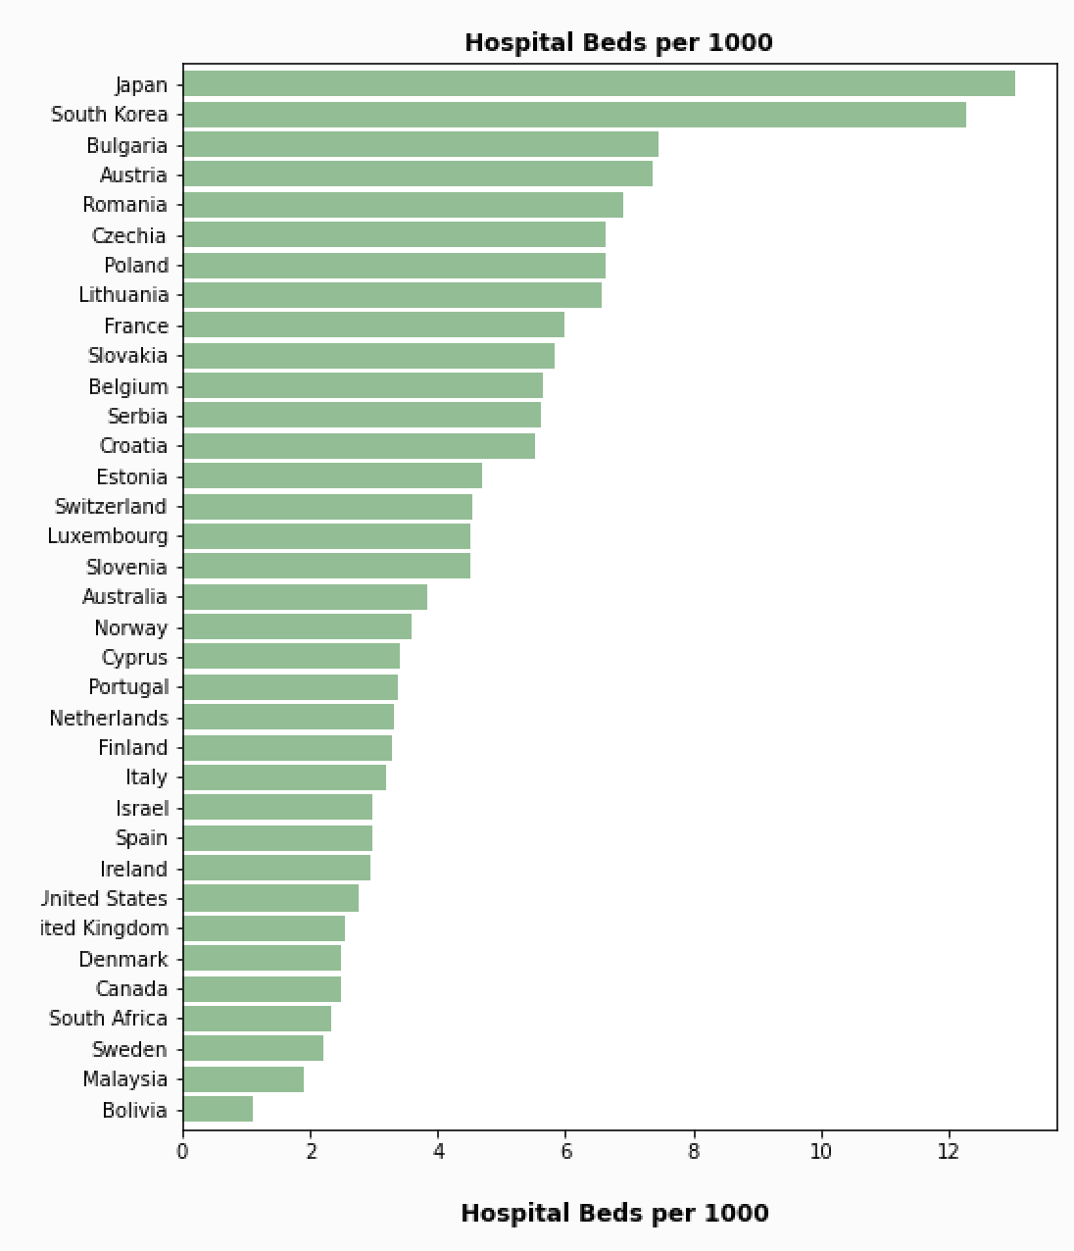
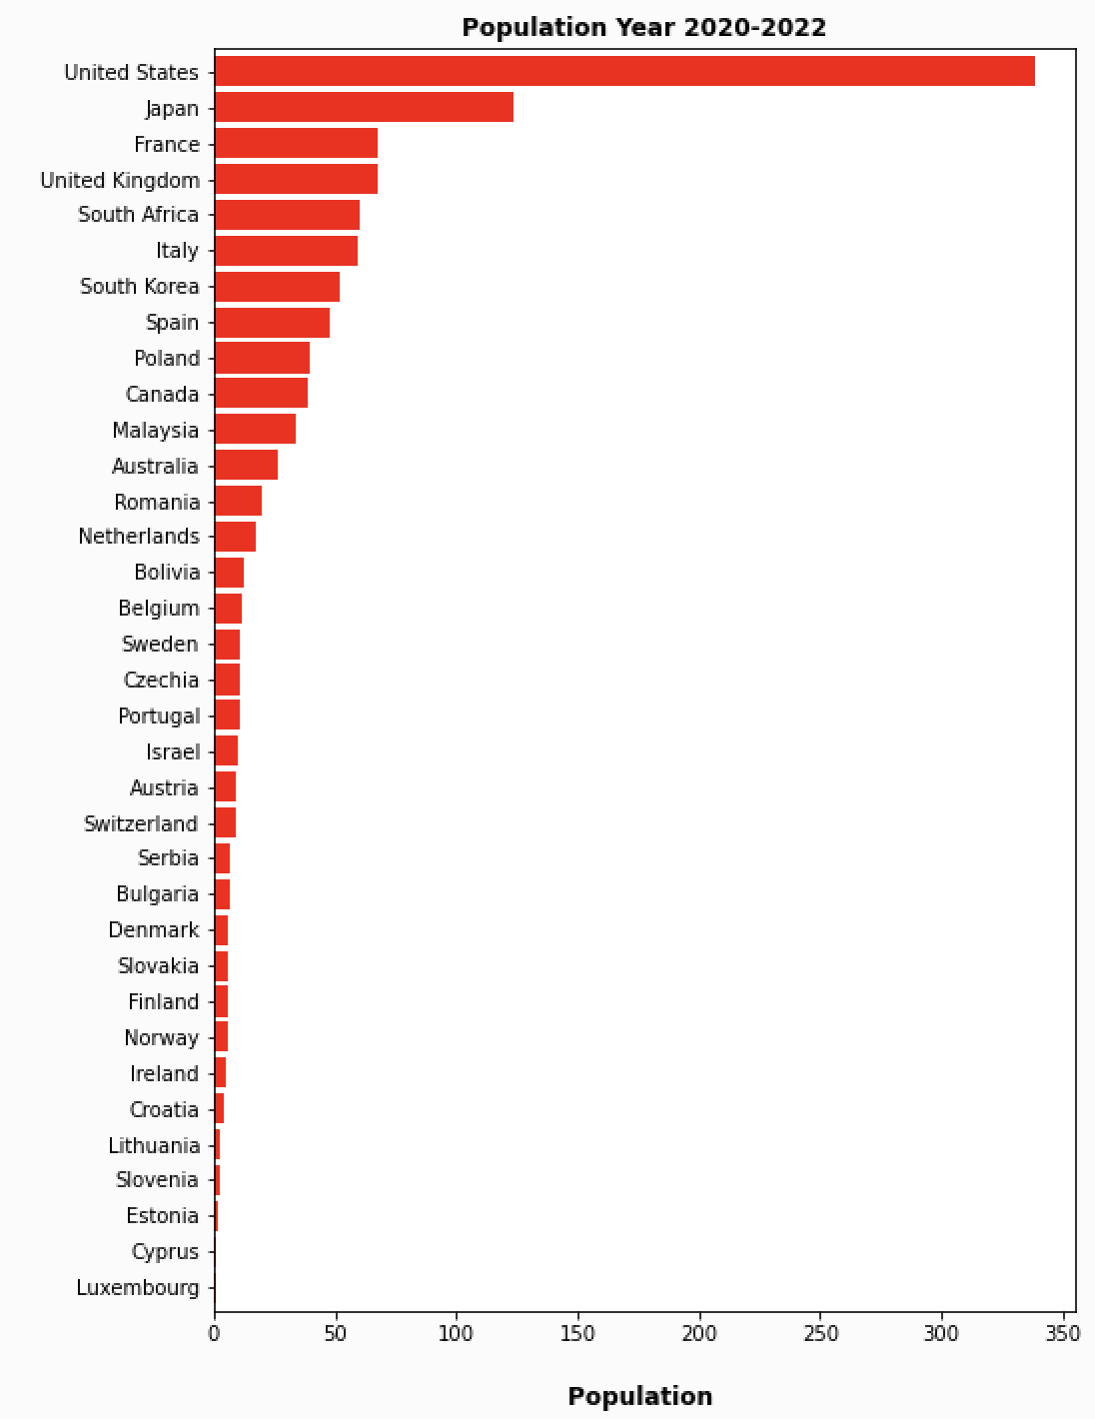
Availability of hospital beds varies across countries with different population sizes
Assessing the availability of hospital beds relative to population size
Smaller population, higher hospital beds
Moderate population, moderate hospital Beds
Larger population, lower hospital beds

Slide 14
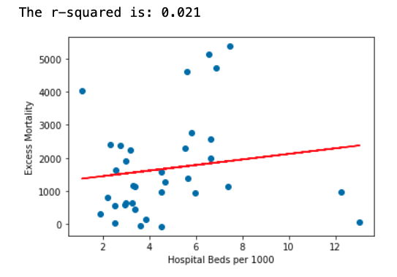
Excess Mortality vs Hospital Beds per 1000
Excess Mortality: excess mortality cumulative per million

Slide 15
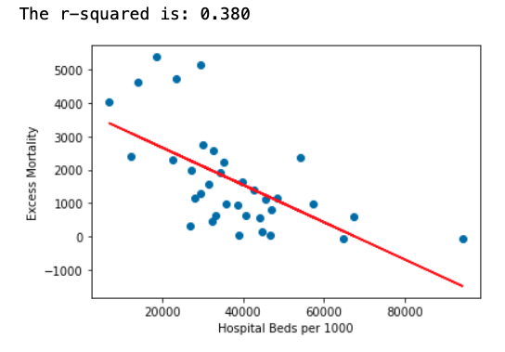
Excess Mortality vs GDP per capita

Slide 16
What is the correlation between Covid 19 cases and tests?

Slide 17
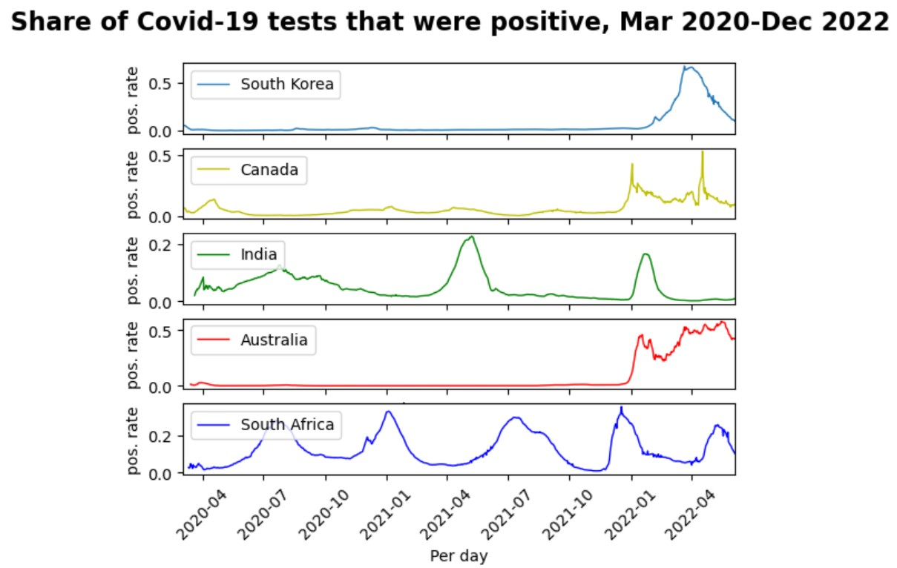
Positive Rate
7-day rolling average of daily cases, divided by 7-day rolling average of daily tests
Good measure for how adequately countries are testing
Understanding the data:
Only results from PCR and antigen tests are included
The number of tests does not refer to the same in each country.

Slide 18
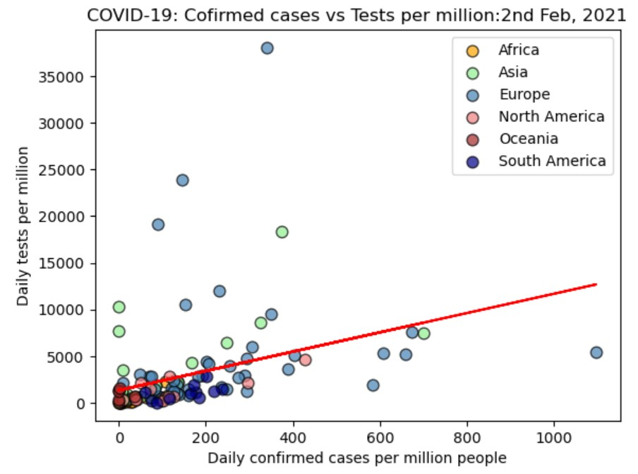
Confirmed cases vs Tests
Both axis are rolling 7-day average
Correlation factor = 0.36

Slide 19
Recommendation for Further Analysis
Apply analysis to understand the effect of vaccines on all continents (only looked at the Americas and Europe)
Look at the effects of covid policies for individual countries (outliers such as Sweden and China)
Expand analysis to include other factors
Age groups
Pre-existing health conditions
Different vaccine brands rolled-out in different countries/continents

